Slide 1



COMPSCI 326
Lecture 06: JavaScript, HTML, and the DOM

Slide 2
Resources
MDN Web Docs
HTML Element Reference (you can find everything here!)
<script>: The Script element - HTML: Hypertext Markup Language
<form> - HTML: Hypertext Markup Language
<label> - HTML: Hypertext Markup Language
<input>: The Input (Form Input) element - HTML: Hypertext Markup Language
<input type="button"> - HTML: Hypertext Markup Language
Using the W3C DOM Level 1 Core
You can also learn more by watching this:
JavaScript beginner tutorial 27 - forms

Slide 3
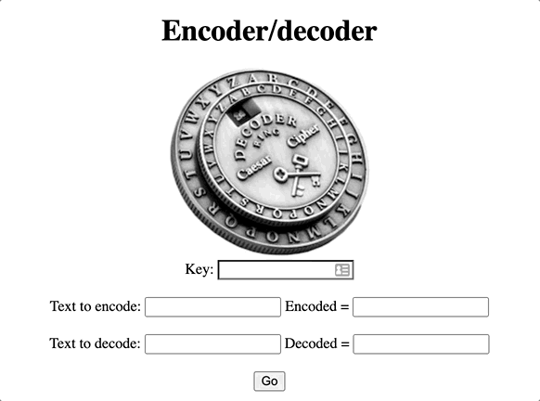
Today
GOAL (in-class exercise): make a web interface for the decoder functions.
We will be using HTML, scripts, and the DOM (Document Object Model) to do this

Slide 4
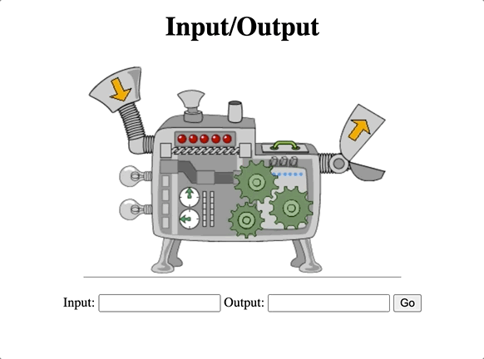
Jamboard
We want to build web applications.
There are many ways to do this.
First, we will look at how to build applications with a user interface.
This requires HTML and JS.
Let us take a look at HTML and build up to the application on the right!

Slide 5

The End

